Slide 1


ESSAY Question #6 ~ 21 Steps to your eCommerce Site
CIS 234E
Electronic Commerce
Website
Your Student ID
your email address
Email to “DrV”
ProfessorVillegas@gmail.com
Place your pix above
And name below
Page 1
CIS 234E ~ ELECTRONIC COMMERCE WEBSITE * YOUR FULL NAME + Phone Number

Slide 2
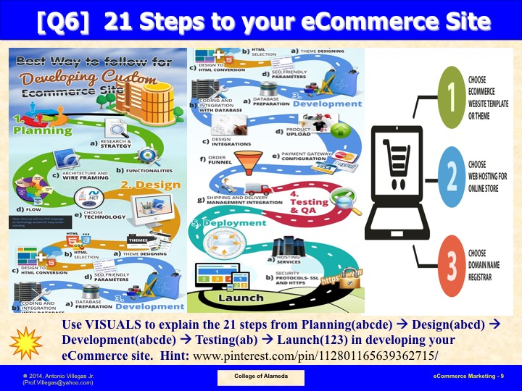
Page 2
CIS 234E ~ ELECTRONIC COMMERCE WEBSITE * YOUR FULL NAME + Phone Number

Slide 3
ESSAY Question 6 ~ Explain the 21 Details of E-Commerce Web site development
1 Research
11 Coding Integration
E-COMMERCE
WEB SITE
2 Functionalities
12 Design Integration
3 Wire framing
13 Product upload
4 Flow
14 Payment configuration
5 Technology choice
15 Order funnel
6 Theme design
16 Shipping Integration
7 HTML selecttion
17 Testing & QA
8 HTML cconversion
18 Hosting services
9 SEO parameters
21 LAUNCH
19 Register Domain Name
10 Database preparation
20 Security SSL + HTTPS
Identify each of the 21 Details of eCommerce website development
Page 3
CIS 234E ~ ELECTRONIC COMMERCE WEBSITE * YOUR FULL NAME + Phone Number

Slide 4
ESSAY Question 6 ~ Explain E-Commerce Web site development ~ STEP 1
1 Research
Display a picture above and briefly describe here this STEP to Website Development
Page 4
CIS 234E ~ ELECTRONIC COMMERCE WEBSITE * YOUR FULL NAME + Phone Number

Slide 5
ESSAY Question 6 ~ Explain E-Commerce Web site development ~ STEP 2
2 Functionalities
Display a picture above and briefly describe here this STEP to Website Development
Page 5
CIS 234E ~ ELECTRONIC COMMERCE WEBSITE * YOUR FULL NAME + Phone Number

Slide 6
ESSAY Question 6 ~ Explain E-Commerce Web site development ~ STEP 3
3 Wire framing
Display a picture above and briefly describe here this STEP to Website Development
Page 6
CIS 234E ~ ELECTRONIC COMMERCE WEBSITE * YOUR FULL NAME + Phone Number

Slide 7
ESSAY Question 6 ~ Explain E-Commerce Web site development ~ STEP 4
4 Flow
Display a picture above and briefly describe here this STEP to Website Development
Page 7
CIS 234E ~ ELECTRONIC COMMERCE WEBSITE * YOUR FULL NAME + Phone Number

Slide 8
ESSAY Question 6 ~ Explain E-Commerce Web site development ~ STEP 5
5 Technology choice
Display a picture above and briefly describe here this STEP to Website Development
Page 8
CIS 234E ~ ELECTRONIC COMMERCE WEBSITE * YOUR FULL NAME + Phone Number

Slide 9
ESSAY Question 6 ~ Explain E-Commerce Web site development ~ STEP 6
6 Theme design
Display a picture above and briefly describe here this STEP to Website Development
Page 9
CIS 234E ~ ELECTRONIC COMMERCE WEBSITE * YOUR FULL NAME + Phone Number

Slide 10
ESSAY Question 6 ~ Explain E-Commerce Web site development ~ STEP 7
7 HTML selecttion
Display a picture above and briefly describe here this STEP to Website Development
Page 10
CIS 234E ~ ELECTRONIC COMMERCE WEBSITE * YOUR FULL NAME + Phone Number

Slide 11
ESSAY Question 6 ~ Explain E-Commerce Web site development ~ STEP 8
8 HTML cconversion
Display a picture above and briefly describe here this STEP to Website Development
Page 11
CIS 234E ~ ELECTRONIC COMMERCE WEBSITE * YOUR FULL NAME + Phone Number

Slide 12
ESSAY Question 6 ~ Explain E-Commerce Web site development ~ STEP 9
9 SEO parameters
Display a picture above and briefly describe here this STEP to Website Development
Page 12
CIS 234E ~ ELECTRONIC COMMERCE WEBSITE * YOUR FULL NAME + Phone Number

Slide 13
ESSAY Question 6 ~ Explain E-Commerce Web site development ~ STEP 10
10 Database preparation
Display a picture above and briefly describe here this STEP to Website Development
Page 13
CIS 234E ~ ELECTRONIC COMMERCE WEBSITE * YOUR FULL NAME + Phone Number

Slide 14
ESSAY Question 6 ~ Explain E-Commerce Web site development ~ STEP 11
11 Coding Integration
Display a picture above and briefly describe here this STEP to Website Development
Page 14
CIS 234E ~ ELECTRONIC COMMERCE WEBSITE * YOUR FULL NAME + Phone Number

Slide 15
ESSAY Question 6 ~ Explain E-Commerce Web site development ~ STEP 12
12 Design Integration
Display a picture above and briefly describe here this STEP to Website Development
Page 15
CIS 234E ~ ELECTRONIC COMMERCE WEBSITE * YOUR FULL NAME + Phone Number

Slide 16
ESSAY Question 6 ~ Explain E-Commerce Web site development ~ STEP 13
13 Product upload
Display a picture above and briefly describe here this STEP to Website Development
Page 16
CIS 234E ~ ELECTRONIC COMMERCE WEBSITE * YOUR FULL NAME + Phone Number

Slide 17
ESSAY Question 6 ~ Explain E-Commerce Web site development ~ STEP 14
14 Payment configuration
Display a picture above and briefly describe here this STEP to Website Development
Page 17
CIS 234E ~ ELECTRONIC COMMERCE WEBSITE * YOUR FULL NAME + Phone Number

Slide 18
ESSAY Question 6 ~ Explain E-Commerce Web site development ~ STEP 15
15 Order funnel
Display a picture above and briefly describe here this STEP to Website Development
Page 18
CIS 234E ~ ELECTRONIC COMMERCE WEBSITE * YOUR FULL NAME + Phone Number

Slide 19
ESSAY Question 6 ~ Explain E-Commerce Web site development ~ STEP 16
16 Shipping Integration
Display a picture above and briefly describe here this STEP to Website Development
Page 19
CIS 234E ~ ELECTRONIC COMMERCE WEBSITE * YOUR FULL NAME + Phone Number

Slide 20
ESSAY Question 6 ~ Explain E-Commerce Web site development ~ STEP 17
17 Testing & QA
Display a picture above and briefly describe here this STEP to Website Development
Page 20
CIS 234E ~ ELECTRONIC COMMERCE WEBSITE * YOUR FULL NAME + Phone Number

Slide 21
ESSAY Question 6 ~ Explain E-Commerce Web site development ~ STEP 18
18 Hosting services
Display a picture above and briefly describe here this STEP to Website Development
Page 21
CIS 234E ~ ELECTRONIC COMMERCE WEBSITE * YOUR FULL NAME + Phone Number

Slide 22
ESSAY Question 6 ~ Explain E-Commerce Web site development ~ STEP 19
19 Register Domain Name
Display a picture above and briefly describe here this STEP to Website Development
Page 22
CIS 234E ~ ELECTRONIC COMMERCE WEBSITE * YOUR FULL NAME + Phone Number

Slide 23
ESSAY Question 6 ~ Explain E-Commerce Web site development ~ STEP 20
20 Security SSL + HTTPS
Display a picture above and briefly describe here this STEP to Website Development
Page 23
CIS 234E ~ ELECTRONIC COMMERCE WEBSITE * YOUR FULL NAME + Phone Number

Slide 24
ESSAY Question 6 ~ Summary
1 Planning
2 Analysis/Design
3 Development
4 Testing & QA
5 Deployment
Summarize the 21 steps with pictures on the 5 Phases of Web Development
Page 24
CIS 234E ~ ELECTRONIC COMMERCE WEBSITE * YOUR FULL NAME + Phone Number

Slide 25
ESSAY Question 6 ~ Bibliographical References
Use MLA Citation for your Bibliography entries
~ go to this website for help
➔ https://www.refme.com/us/citation-generator/mla/
Page 25
CIS 234E ~ ELECTRONIC COMMERCE WEBSITE * YOUR FULL NAME + Phone Number

